Slide 1

Implementation of Quantum Walk on four Vertex cycle
Name : Sohail Maidargi
USN : 4NI18EC088
College : The National Institute Of Engineering, Mysore

Slide 2
Problem Definition: [Quantum Minimal Spanning Tree]
The Network Design to find the minimum spanning tree , lets assume we are given a region for maintaining the Network of Roads , and there exist segment that needs to be repaired and the expenses need to be reduced and it must be budget friendly then we can design a Road Network as a Graph ,with minimal spanning tree.

Slide 3
Solution to given issue
Let's consider a Graph 𝐺 = (𝑉 , 𝐸) consisting of V number nodes , Set of E pair of nodes ,The will be complete if between two nodes there exists a edge connecting two nodes.
A spanning tree of a connected graph 𝐺 = (𝑉 , 𝐸) is the graph 𝑇 = (𝑉 , 𝐸𝑇 ) where 𝐸𝑇 ⊂ 𝐸 and 𝑇 contains no cycles. It is not hard to see that a graph 𝑇 is a spanning tree if and only if 𝑇 is connected and has 𝑛 nodes and 𝑛 − 1 edges.
A weighted graph is a graph 𝐺 = (𝑉 , 𝐸,𝑤) where 𝑤 is a map on the edges 𝑤 : 𝐸 → R. A minimal spanning tree of a graph 𝐺 is then a spanning tree 𝑇 = (𝑉 , 𝐸𝑇 ) which minimizes

Slide 4
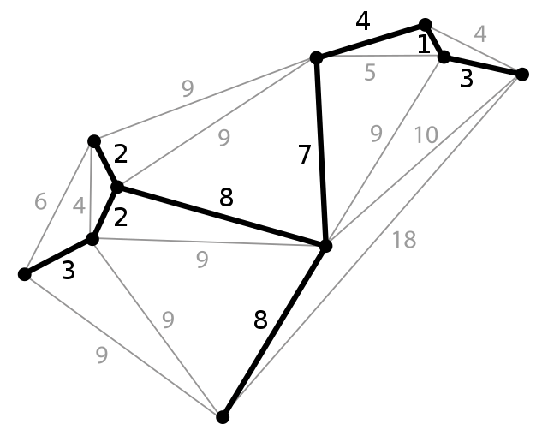
Algorithm Description :
Let’s consider the case where 𝐺 is
presented as a list of edges ,In Quantum
Algorithm we deal this issue using
Boruka's Algorithm.
This algorithm requires only 𝑂( √ 𝑛𝑚)
queries where 𝑛 is the number of
nodes and 𝑚 the number of edges in the graph.

Slide 5
Boruvka’s Algorithm :
Starting with each node as a distinct tree, find the minimal weighed edge between each tree and the rest of the trees. The direction of the solid edges indicates the edge is the minimal weighted edge for the source node.
The components connected by solid edges will form the trees at the start of the second run of step of Borůvka’s algorithm

Slide 6
Description :
Boruvka’s algorithm builds a collection of disjoint trees (i.e., a forest) and successively merges by adding minimal weight edges.
1. Let T be the collection of 𝑛 disjoint trees, each consisting of exactly one node from the graph 𝐺.
2. (a) For each tree 𝑇𝑖 in T find the minimal weighted edge, 𝑒𝑖 , of 𝐺 between 𝑇𝑖 and the other trees of T.
(b) Merge the trees {𝑇𝑖 ∪ {𝑒𝑖 }} so that they are disjoint: set this new collection to T

Slide 7
If there are 𝑘 trees in T at a given iteration of Step (2), then the algorithm performs 𝑘 searches for the respective minimal weighted edges.
As the trees are disjoint, we can perform the 𝑘 searches in one sweep by inspecting each of the 𝑚 edges of 𝐺 once. As there will be at most “log𝑛” iterations of Step (2), this results in a running time of 𝑂(𝑚 log𝑛).
The quantum algorithm takes advantage of the Grover search algorithm, to speed up the searches in Step (2).
In the algorithm above, we need to find the minimal element of an appropriate list. Clearly this can not be implemented directly as an oracle without actually inspecting each of the list elements.
. One of these marked elements can then be found using 𝑂( √︃ 𝑁/ 𝑀 ) queries to the oracle.

Slide 8
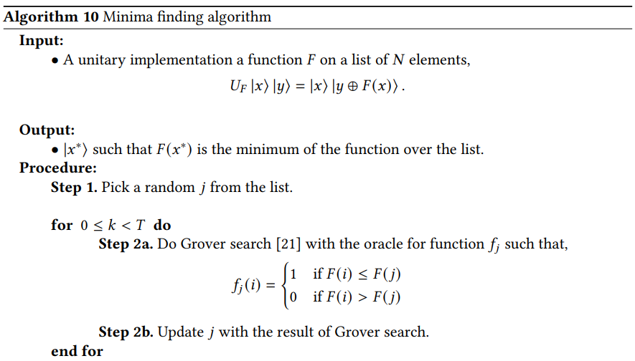

Slide 9
Drawbacks:
A probabilistic analysis shows that𝑇 = 22.5 √ 𝑁 +1.4 log2 2 (𝑁) suffices to find the minimal element with high probability .
The inner loop of the algorithm uses a Grover search routine with potentially multiple marked items. But the number of marked items is not known beforehand.
This poses problem as Grover search being a unitary algorithm needs to be stopped exactly at the right number of iterations to give the correct answer.
Running the procedure for longer deteriorates the quality of the answer. If the number of marked items is unknown the stopping criterion of the algorithm is also unknown.

Slide 10
THANK YOU

